Slide 1
Project: Virtual Queue 2.0 Student: Kenneth Kon Michael Lazo Mentor: Bernard Parenteau
Sprint 5 Presentation
CIS 4911 Senior Project
School of Computing and Information Sciences
Florida International University
<04/20/2015>

Slide 2
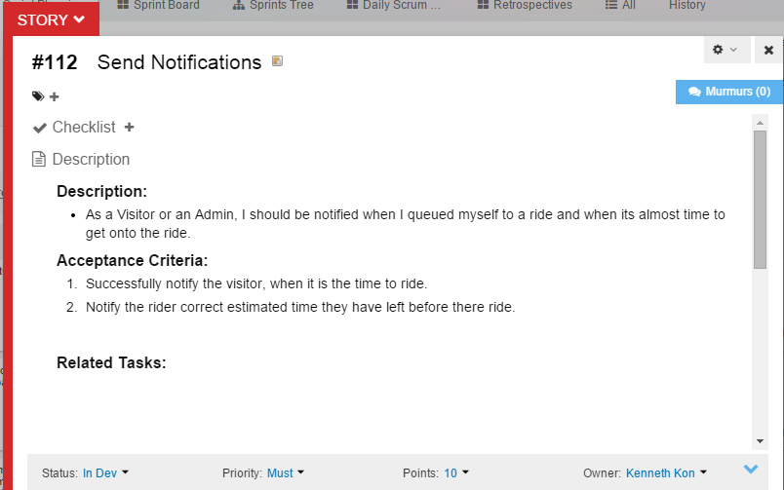
User Story
Sprint Velocity:
30 per Sprint

Slide 3
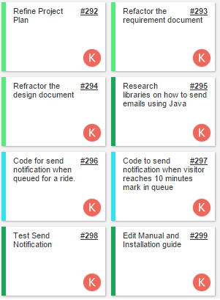
User Story: Tasks

Slide 4
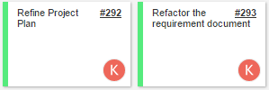
Daily Scrums 1 & 2
Daily Scrum 1
Sprint 4 presentation preparation
Sprint 4 presentation
Estimated points to work on: 5 points
Actual number of points work on: 4 points
Daily Scrum 2
Requirement Elicitation with Product owner
Start editing Project plan and Requirement Documentation.
Create Gantt chart, user case, sequence Diagram.
Estimated points to work on: 5 points
Actual number of points work on: 4 points

Slide 5
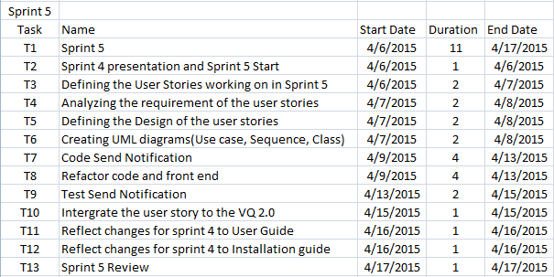
Added in Feasibility and Project Plan Document

Slide 6
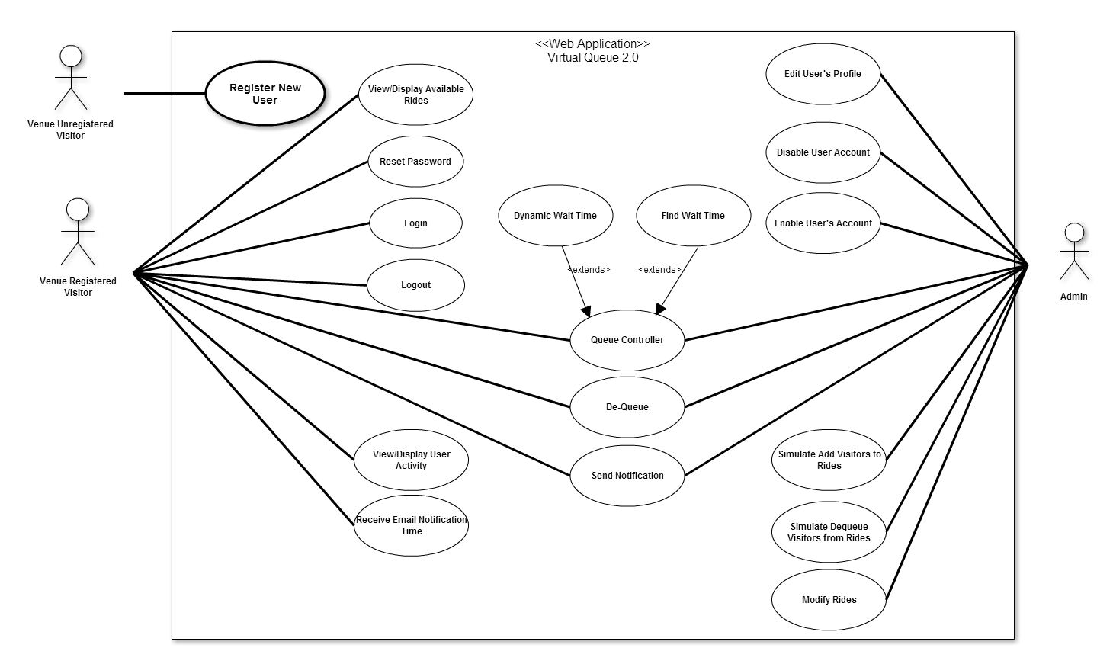
Use Case Diagram:
Edited in Requirement Document

Slide 7
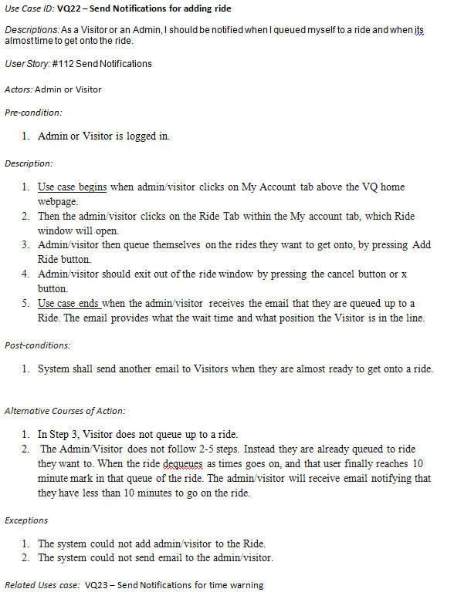
Use Case:
Added In Requirement Document

Slide 8
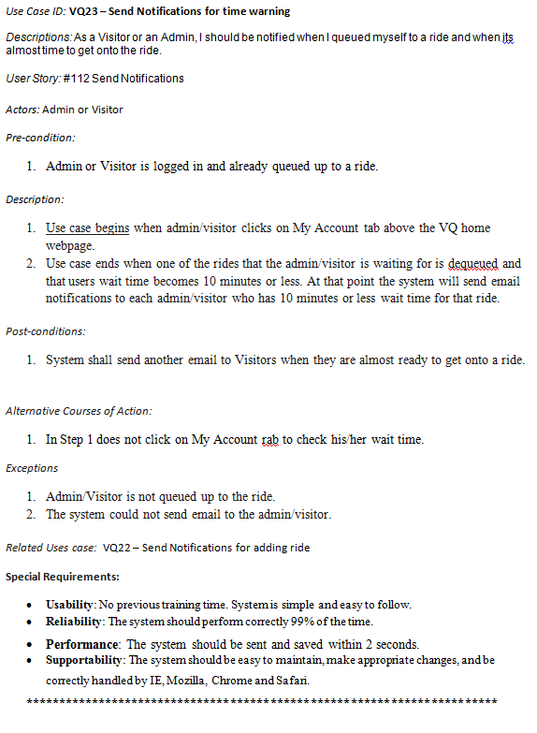
Use Case:
Added In Requirement Document

Slide 9
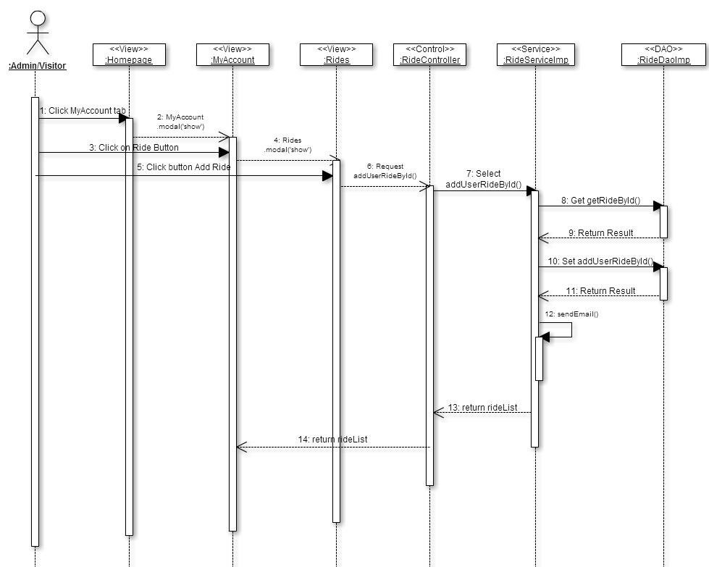
Sequence Diagram: Added In Requirement Document

Slide 10
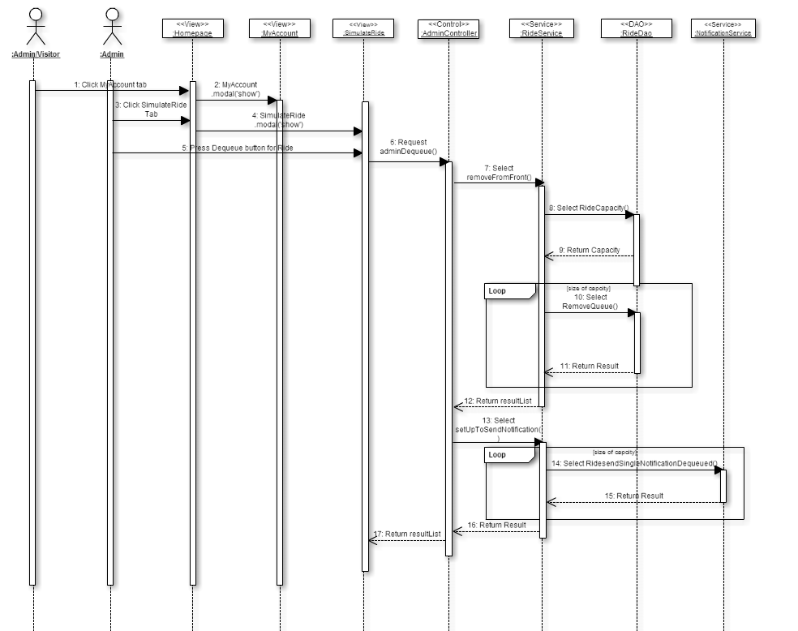
Sequence Diagram: Added In Requirement Document

Slide 11
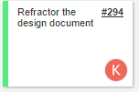
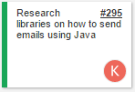
Daily Scrums 3 & 4
Daily Scrum 3
Edit Design Document, Create Class diagram for Send Notifications.
Estimated points to work on: 5 points
Actual number of points work on: 4 points
Daily Scrum 4
Start coding for Send Notification.
First research how to send emails using Java, or other API’s.
Estimated points to work on: 5 points
Actual number of points work on: 4 points

Slide 12
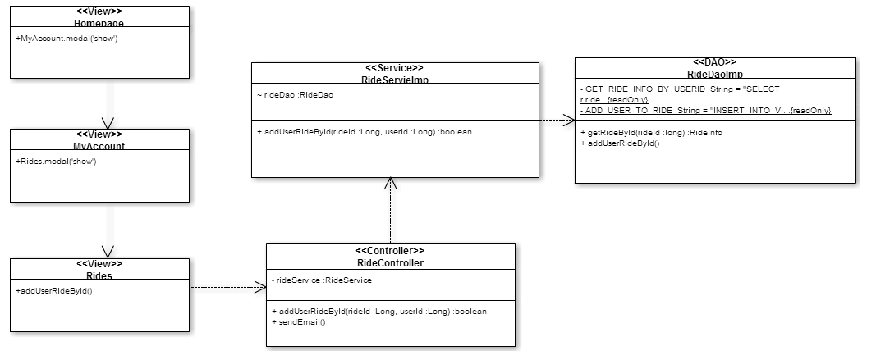
Class Diagram: Added in Design Document

Slide 13
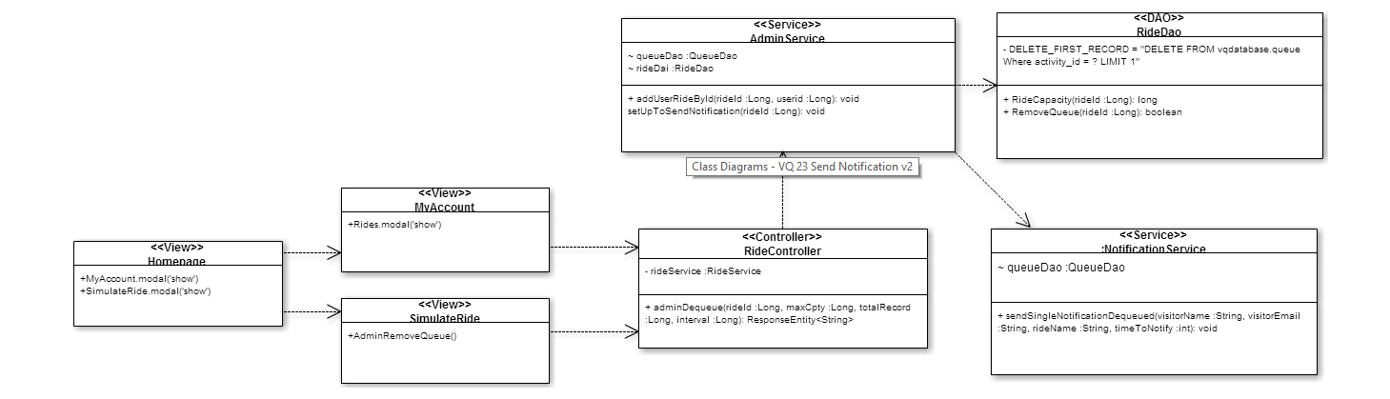
Class Diagram: Added in Design Document

Slide 14
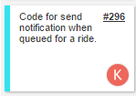
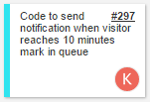
Daily Scrums 5 & 6
Daily Scrum 5
Continue coding for send notification when queued for a ride.
Estimated points to work on: 5 points
Actual number of points work on: 4 points
Daily Scrum 6
Finish coding for send notification when queued for a ride.
Start coding to send notification when visitor reaches 10 minutes mark in queue.
Estimated points to work on: 5 points
Actual number of points work on: 3 points

Slide 15
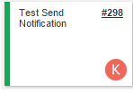

Daily Scrums 7 & 8
Daily Scrum 7
Finish coding to send notification when visitor reaches 10 minutes mark in queue.
Start testing the code.
Estimated points to work on: 4 points
Actual number of points work on: 3 points
Daily Scrum 8
Finish testing the code.
Edit User Manual and Installation guide.
Start working on presentation slides and sprint 5 presentation
Estimated points to work on: 4 points
Actual number of points work on: 3 points

Slide 16
Demo

Slide 17
Daily Scrums 9 & 10
Daily Scrum 9
Finish working on presentation slides and sprint 5 presentation
Make any changes (Correction) to UML diagrams.
Estimated points to work on: 4 points
Actual number of points work on: 3 points
Daily Scrum 10
Sprint 5 Review with our product owner
Estimated points to work on: 2 points
Actual number of points work on: 2 points
Total Points Estimated to Work on: 44 Points
Total Points Actually Done: 34 Points

Slide 18
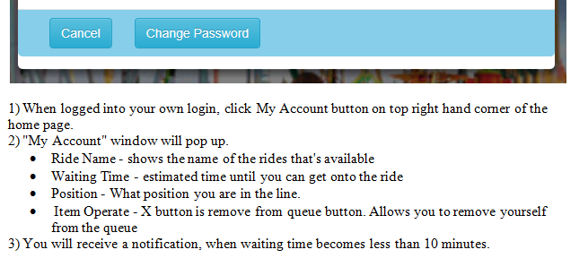
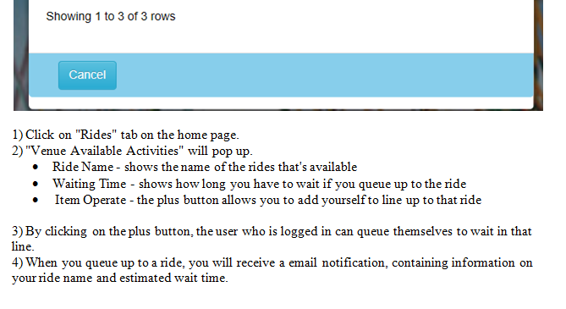
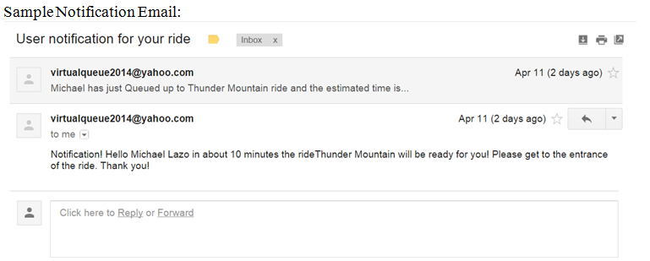
Edited the My Account section of User Guide
No edits made to Installation Manual

Slide 19
Sprint 5 Report
Send Notification(Accepted)

Slide 20
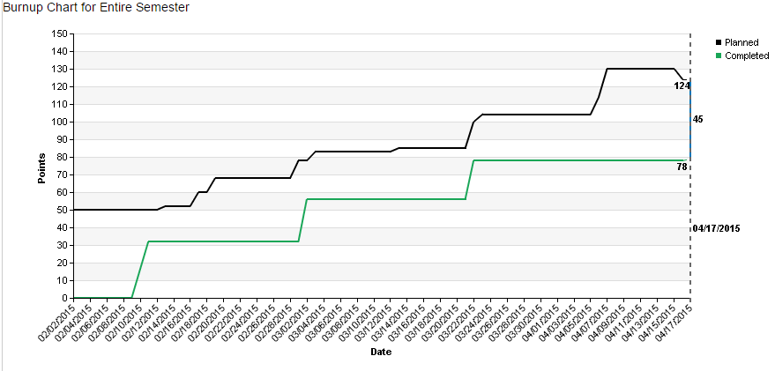
Burn-up charts

Slide 21
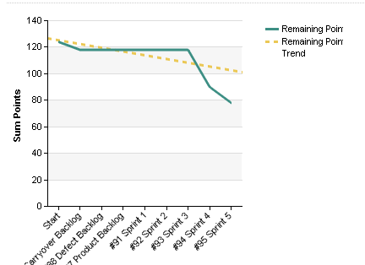
Burn Down charts

Slide 22
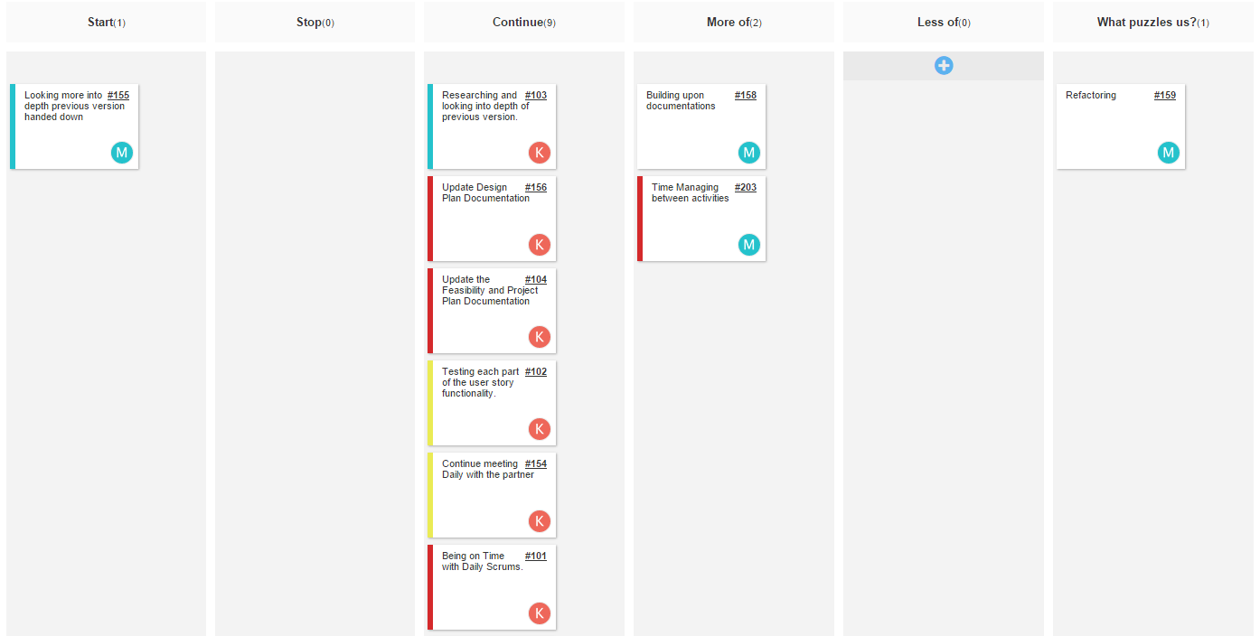
Retrospectives

Slide 23
Final Presentation
Almost there!

